Slide 1
Towards a progressive and more coherent
social policy framework:
connecting concerns, notions and discourses.
A think piece
UN DESA Expert Group Meeting on
"Strengthening social development in the contemporary world"
New York, May 2015
Gabriele Köhler
UNRISD Visiting Fellow

Slide 2
Flow of thinking
World we want vs world we have
What is social development?
What is social policy?
The scope for - progressive - social policy in the SDG era
Conclusion?
Notes:
http://reliefweb.int/sites/reliefweb.int/files/resources/OCHANepalEarthquakeSituationReportNo.16%2818May2015%29.pdf

Slide 3
1) World we want vs world we have

Slide 4

Notes:
In 2012, 20 years after the first Rio conference on sustainable development, the UN convened this conference. It adopted an outcome document called The Future we want.
In 2015, the MDG agenda is under review and a new development agenda will combine the MDG process with the Rio process.
The future we want approach contrasts with the situation we have ---

Slide 5

Picasso painting for $179 Million
Private wealth
http://www.npr.org/sections/thetwo-way/2015/05/11/406036959/photos-sculpture-sells-for-141m-picasso-painting-for-179m-both-records
Notes:
Enormous private wealth contrasts with enormous public poverty.
This painting was sold at an auction in New with a few minutes. (May 2015)
http://www.npr.org/sections/thetwo-way/2015/05/11/406036959/photos-sculpture-sells-for-141m-picasso-painting-for-179m-both-records

Slide 6
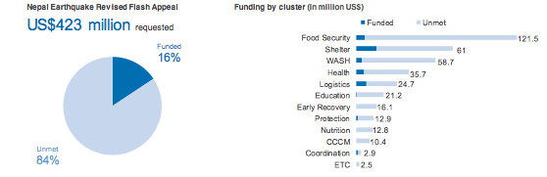
Nepal earthquake response needs $420 mill, receives $66 mill
enormous public poverty
Notes:
A the same time, also in May 2015, 2 and a half weeks weeks after an earthquake in one of the world’s income-poorest countries, Nepal, was able to raise only $66 million % - out of an estimated 420 million needed for immediate recovery.
http://reliefweb.int/sites/reliefweb.int/files/resources/OCHANepalEarthquakeSituationReportNo.16%2818May2015%29.pdf

Slide 7
Intra and inter-Country Inequality, 2007
Constant US$, 2000 value
Source: Ortiz and Cummins (2011) UNICEF
Source: Ortiz and Cummins. 2011. Global Inequality. UNICEF
Notes:
Source: http://www.unicef.org/socialpolicy/files/Global_Inequality.pdf
Inequalty, in incomes and wealth has reached unprecedented heights. This figure shows that the highest income quintile in the income-richest country, Luxemburg, has 100 000 times the income of the lowest income quintile in the world’s income-poorest country, DRC.
Note: Each vertical column represents the income of one quintile of one country. Here, the tallest block in the back corner reflects the income of the richest quintile of the population of Luxembourg, while the column that is barely discernible in the nearest corner represents the income of the poorest quintile of the population of the Democratic Republic of Congo. Overall, this figure captures data for 135 countries as of 2007 using constant 2000 U.S. dollars.

Slide 8
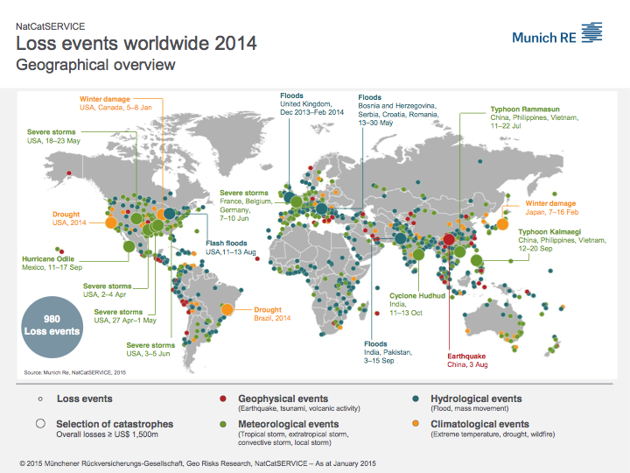
Notes:
http://www.munichre.com/site/corporate/get/documents_E-55411850/mr/assetpool.shared/Documents/5_Touch/Natural%20Hazards/NatCatService/Annual%20Statistics/2014/mr-natcatservice-naturaldisaster-2014-Loss-events-worldwide-geographical.pdf
Apart from the disaster of public poverty due to austerity politics and the ideology of a small state with low tax revenues, compounded by massive tax evasion, there is a marked increase in natural disasters – which generally hit the lowest income groups the most.

Slide 9
Alternative notions of social development/social policy
Integrating sustainability
Recognising and using the concept of “capitalism” to explain public poverty and private wealth, and planetary destruction
Replacing the primacy of the profit motif in favour of ecological sustainability and social equity
Notes:
So there is an urgent need for new thinking – and action – on social development and social policy.
Literature on “capitalism”:
Enwezor O. (2015). All the World’s Futures, http://www.labiennale.org/en/art/exhibition/enwezor/
Klein, N. (2014) This changes everything. Capitalism vs. The Climate, New York: Simon & Schuster.
Piketty, T. (2014) Capital in the Twenty-First Century, Boston, Harvard University Press.
Pope Francis (2013) Evangelii gaudium. Apostolic exhortation. 2.vatican.va/content/francesco/en/apost_exhortations/documents/papa-francesco_esortazione-ap_20131124_evangelii-gaudium.html
Pascal van Griethuysen 2012. Bona diagnosis – bona curatio. How property economics clarifies the degroth debate. Ecological economics. www.elsevier.com

Slide 10
2) Social development
Notes:
First. A need to (re)define social development

Slide 11
EVOLUTION OF THE SOCIAL DEVELOPMENT NOTION
Income, Health, Education, Gender, Environment
OWG
UNDP
MDGs
Human Development
Income, Health, Education
Sustainable Human Development
Income, Decent Work, Health, Education, Energy, Environment, Security
ILO-DESA
UNEP Rio
Social Development
Poverty, Employment, Social Inclusion
Sustainable Development
1990
1995
2000
2012
2015
1993/4
1997
2003
2014
DESA
UNDP Latvia
DESA
UNDP
Poverty Eradication Decade
Human Security
Income, Health, Education, Environment, Security, Subjective and Objective
Human Security
Income, Health, Education, Environment, Security
Social Sustainability
Source: the author
Notes:
Looking at social development as the notion has evolved over time in the UN system shows a variety of terms used with different but related connotations. It would be useful for the various UN researchers to referand relate to each’s other’s concepts.

Slide 12
ONTOLOGY
mapping of meaning of words = specification of a conceptualisation
each group associates different meaning

Slide 13
Social development
Working for a convergence of meanings
Referring to each other’s terminology
Using social development concept to shape social policy

Slide 14
3) Social policy
Notes:
Social policy too has different meanings to different groups and “schools” of thought. It is useful to discuss which policy areas are to be included in social policy and what the boundaries are.

Slide 15
Social policy traditions
“Nordic” welfare state tradition
Intended policy outcomes
SDGs
Notes:
There are many schools of thought on social policy. Two of them are
the literature around the Nordic welfare state, building on a discussion initiated by Esping Andersen, and describing different roles of the state, the community and the family in the social area .
Another school of thought tends to organise social policy by intended outcomes.
The SDGs now under discussion could merge the 2 traditions.

Slide 16
Table 1. Social policy – different approaches
Policy domain | Primary social development objective | Welfare state role/ rights approach | Human Security objectives |  | “Function”/Outcome | SDG reference
Policies addressingcpublic goods/services | Human/social development; Right to basic social goods and services | √
Food and nutrition
 |  |  | √ |  | “protection” in wide sense of word | SDG 2
Education |  | √ | √ |  |  | SDG 4
Health |  | √ | √ |  |  | SDG 3
Drinking water and sanitation measures |  |  |  |  |  | SDG 6
Housing programmes |  | √
Electricity /access to energy |  | √ |  |  |  | SDG 7
Access to transport/transportation |  | √ |  |  |  | SDG 9
Access to communications |  |  |  |  |  | SDG 9
Early child care, elderly care, care for people with disabilities |  |  |  |  | reproduction | SDG 3, 4, 5, 11
Family planning/reproductive health/sexual and reproductive rights |  |  |  |  | reproduction | SDG 3; 5
Notes:
The table is an attempt to classify social policy and its boundaries by different criteria – including by outcomes, and correlate them with the 17 SDGs.

Slide 17
Table 1. Social policy – different approaches
Policy domain | Primary social development objective | Welfare state role/ rights approach | Human Security objectives |  | “Function”/Outcome | SDG reference
ii) Policies addressing socio-economic insecurities | Right to basic income and decent work; Poverty eradication.
Employment schemes for decent work |  | √ | √ |  | production | SDG 8
Youth employment drives |  | √ |  |  |  | SDG 8
Land reform/access to land |  | √ |  |  |  | SDG 5
Tribal land and commodity rights |  | √
Formal sector social insurance |  | √ |  |  | protection | SDG 1
Micro credit/micro asset schemes |  | √ |  |  | protection
Area/regional development |  | √ |  |  | production | SDG 9
Urban renewal |  | √ |  |  |  | SDG 11
Industrial policy |  | √ |  |  | production | SDG 9

Slide 18
iii) Social assistance policies and programmes, addressing income poverty, SPF | Right to basic income; Poverty alleviation | √
Food-security related
 |  | √ | √ |  | protection | SDG 1, 2, 8
Income poverty-related |  | √ | √ |  | protection | SDG 1, 8
Age-related |  |  |  |  | protection
Conflict, emergency-related |  | √ |  |  | protection | SDG 16
iv) Policies for voice and social inclusion | Social inclusion and human rights
Tools for social inclusion |  | √ |  |  | redistribution
Affirmative action legislation for gender, caste, ethnic, religious equality |  | √ |  |  | redistribution | SDG 5
Freedom of media; internet access |  | √ |  |  |  | SDG 16
Freedom of organisation and collective bargaining |  | √ |  |  |  | SDG 8, 16 (implicitly)
Rights of civil society to organise and mobilise |  | √ |  |  | production | SDG 8, 16
Right to information |  | √ |  |  |  | SDG 16
Legal instruments to address exclusion practices |  | √ |  |  | redistribution
Local self governance provisions |  | √
v) Policies for sustainability | Sustainable human development | √ |  |  | production, redistribution | SDGs 12-15
Source: Builds on Koehler 2014.

Slide 19
World Social Summit’s policy spinoffs
Source: the author
Notes:
Another issue in connection with defining the remit of social policy is that the World Social Summit (1995) has two different trajectories or spinoffs – one being the poverty eradication decades with a radical vision centred on employment, social inclusion, and rights, and the other the far better known MDGs – which can be considered a populist or popular way of approaching social policy and poverty issues without calling attention to policy change.

Slide 20
4) The scope for - progressive - social policy in the SDG era?
Linking employment/decent work and minimum income guarantees/social protection floor
Linking employment/decent work and sustainable development
Linking employment/decent work and the care economy
Sustainable consumption and production and social policy
Notes:
The question is now – what is the scope for genuinely transformative or progressive social policy. What are the potential policy synergies?

Slide 21
Linking SPF and decent work
Linking employment/decent work and minimum income guarantees/social protection floor
Minimum income precondition for decent work
Minimum income - the Keynesian demand argument
Making the decent work argument equally “palatable”/popular

Slide 22
Changing the normative hierarchy
Linking employment/decent work and sustainable development
Linking employment/decent work and the care economy
Sustainable consumption and production and social policy
Eco-social rational: economic decisions subordinated to ecological and social justice considerations
  From production of material goods to creation of services
  Recognising planetary boundaries
  Valorising the care economy
Notes:
In order to address some of the inconsistencies and tensions between the various SDG goals – such as the growth orientation versus sustainability – one needs to reverse the hierarchy away from the capitalist logic of growth and accumulation which so far has always been exploitative and resource-intensive.

Slide 23
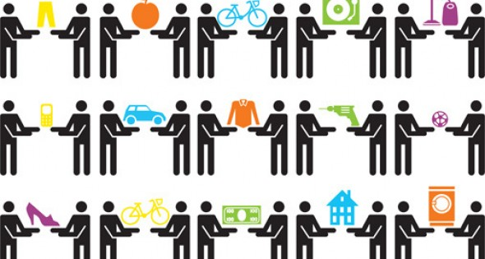
The sharing economy - pointer for post-growth (de-growth)
Source https://www.google.com/search?q=sharing+economy
Notes:
One pointer comes from the sharing economy and the de growth or post-growth movement. It seeks to move away from ever more production of goods to a sharing of goods that are in ample supply in the income rich countries, and also moving to redistribution of incomes, wealth and time use-

Slide 24
Conclusions
Connect social development concerns, notions and discourses for a progressive and more coherent social policy framework
Recognise the impact of the capitalist logic
Radically rethink social policy

