Slide 1
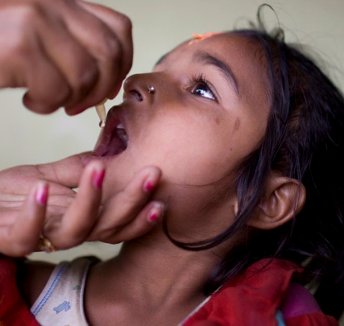
Equity & development
Gabriele Köhler
Development economist, Munich
Ludwig Maximilian University (LMU)
Centre of International Health (CIH)
PhD-Program International Health
Module I
Munich, 22 October 2013
Notes:
Key points:
Understanding of the politics of development cooperation and the „development architecture“
Looking into concepts of equity and human development
Having an overview of international norms on which to base arguments for inclusive health services and equitable access
Making the connection between development cooperation and national and international health policy making

Slide 2
Overview:
I.) Definitions of development
II.) The global political situation - a result of globalisation
III.) The global socio-economic situation
IV.) Current international health financing dynamics
Exercise I
V.) Equity – versus social exclusion, lack of decent, low social protection coverage
VI.) Normative positions that impact on equity
VII.) Outlook: a “development“ agenda beyond 2015
Exercise II

Slide 3
I.) Definitions of development

Slide 4
Development, development cooperation
“Development” and “cooperation”: complex and loaded terms
Which refer to
  economic, social and political change
  The interaction between countries, usually in the form of technical advice or financial transfers

Slide 5
Conceptual definition of
human development
A systematic reflection on
  how human beings live in each society
  what substantive freedoms they enjoy
Notion of the broadening of choices
Economic and social development matter

Slide 6
Operational definition: human development
Original definition (1990)
  Longevity
  Educational attainment
  Income
Concept adjusted for gender, for equity, and for multidimensional aspects of poverty
  (UNDP Human Development Report 2010)
Notes:
The idea of human development goes beyond economic indicators (such as gross national product per capita ) and income poverty.
The 2010 United Nations Development Programme Human Development Report introduced the Multidimensional Poverty Index (MPI). This new international measure of poverty complements income-based poverty measures by reflecting the multiple deprivations that people face at the same time across 104 developing countries. The MPI identifies deprivations across health, education and living standards, and shows the number of people who are multidimensionally poor and the deprivations that they face on the household level. Source: http://www.ophi.org.uk/policy/multidimensional-poverty-index/

Slide 7
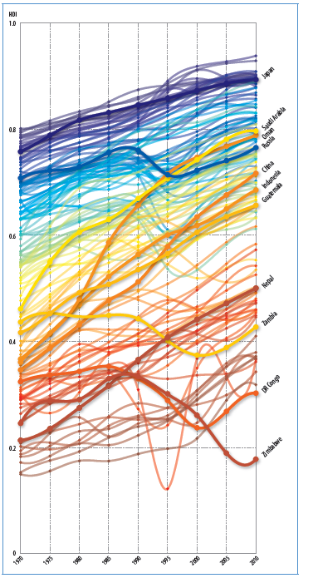
Worldwide trends:
Human Development Index (1970-2010):
Notes:
UNDP Human Development Report 2010.New York. www.undp.org

Slide 8
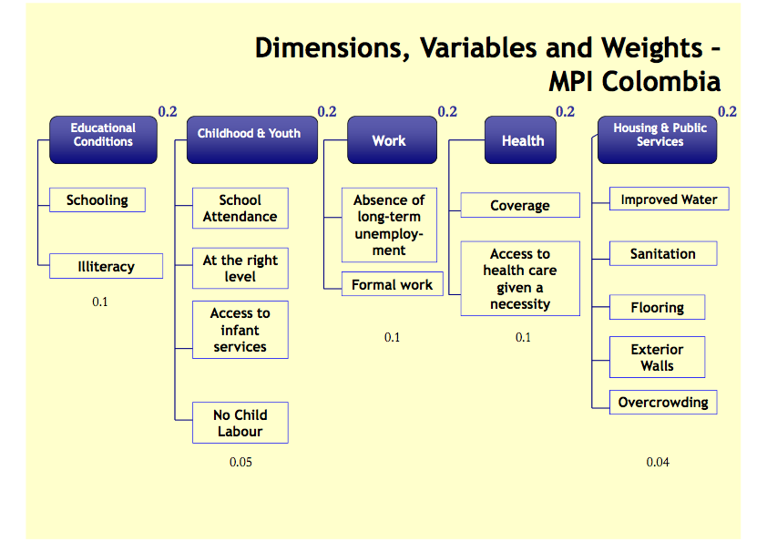
Wellbeing
Multidimensional poverty index (MPI)
Different discourses:
  Wellbeing as objective, subjective and relational
  Multidimensional poverty
  Missing domains
Notes:
Source: Sabine Alkire. Multidimensional poverty index. OPHI. Oxford University

Slide 9
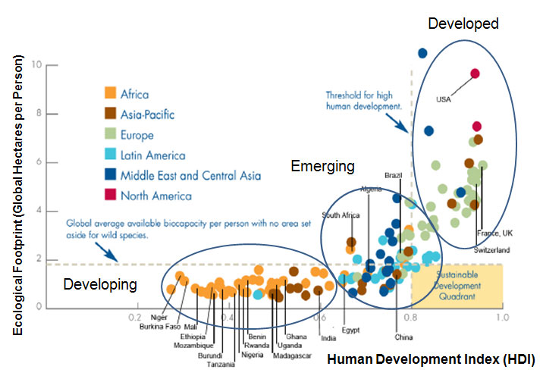
The Global Footprint
Notes:
Source: Global footprint network.
In 2003, Global Footprint Network, a nonprofit organization, introduced the notion of an “Ecological Footprint” — a resource accounting tool. It is a data-driven metric that shows how close we are to the goal of sustainable living. Footprint accounts work like bank statements, documenting whether we are living within our ecological budget or consuming nature’s resources faster than the planet can renew them. http://www.footprintnetwork.org/en/index.php/GFN/page/at_a_glance/
http://www.wbcsd.org/web/eeb/HDI-index.jpg

Slide 10
II.) The global political situation - a result of globalisation

Slide 11
Globalisation: new economic realities
  Winners:
    high growth economies, upper income and wealth groups, successful private sector, private donors taking on the development agenda
  Losers:
    lowest-income countries without natural resources, fragile states, the informal economy, the poor, migrants, the socially excluded, children, women, people with disabilities

Slide 12
Changing global dynamics
193 countries in the world
Organised in the United Nations
Categorised as “developed” and “developing”
“G20” of OECD and other economically successful countries
“BRICS” – highly successful countries of the South
G20 and BRICS splitting the group of “developing countries”, replacing “G193”, and undermining UN processes
Notes:
“G 193” – the 193 member states of the UN – taken as a metaphor for the global community – which, in theory, is the more legitimate group to discuss and decide on global economic, social and political development policies. The UN General Assembly would be the venue for this. It can be remarked however, that governments do not necessarily represent peoples, and some analysts have proposed a global senate of parliamentarians to complement the UN GA.

Slide 13
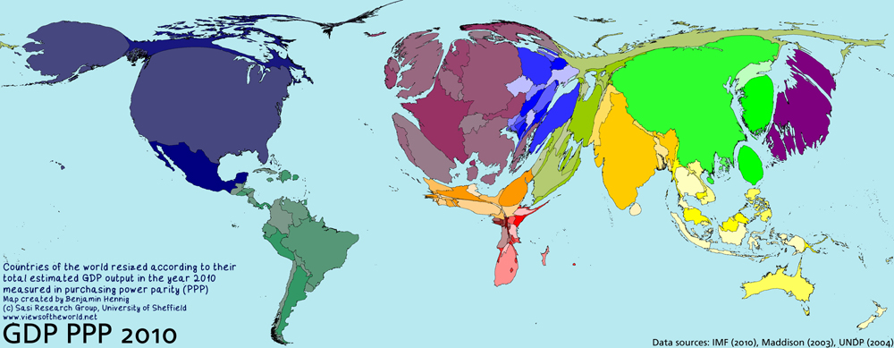
Countries of the world
estimated GDP in purchasing power parity, 2010
s
Notes:
The world re-sized by economic power, measured in GDP PPP ...

Slide 14
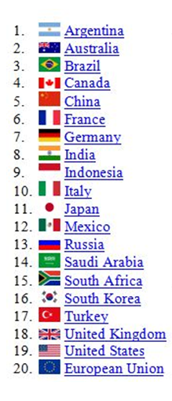
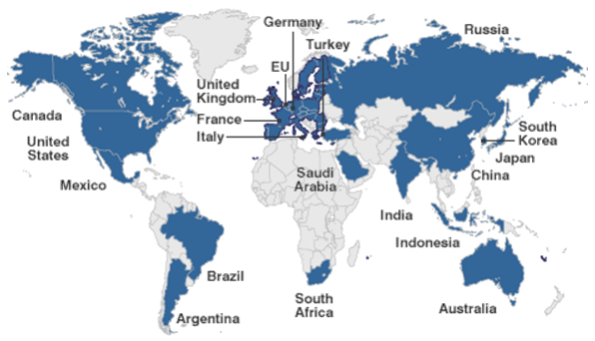
G 20 countries:
Circa 90 per cent of global GNP
80 per cent of world trade
Two-thirds of the world's population. ( Source: http://www.g20.org/about_what_is_g20.aspx
Source: www.bbc.co.uk
Notes:
.... which roughly corresponds to the G20 grouping. G20 established in 1999 compromising the finance ministers and central bank governors of the G7, plus Russian Federation, plus 12 other key countries. It gained momentum in 2008 when it started meeting at head of state level to respond to the massive financial crisis.
Additional members of the G20:
European Union Presidency
European Central Bank
Managing Director of the IMF
President of the World Bank
The Chairman of the Bank/Fund Development Committee
UN Secretary General invited as an observor at the more recent meetings

Slide 15
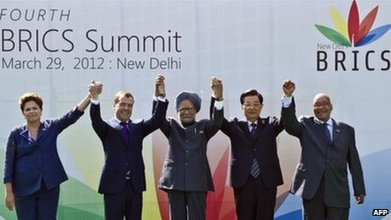
BRICS
Notes:
BRICS: a term coined by an investment analyst who was looking at emerging markets to recommend to investors. These countries – Brazil, Russia, India, China and later South Africa took up the idea and now meet regularly on various topics.
Photo: http://news.bbcimg.co.uk/media/images/59360000/jpg/_59360826_59360704.jpg
(c) AFP

Slide 16
New forms of colonialism
Shifting hierarchies among countries
Landgrab, social and environmental sell-outs by corrupt governments
Development cooperation/official development assistance (ODA) driven by security or commercial interests
Public-private partnerships and private foundations displacing ODA

Slide 17
Converging concerns in North and South
Income gap widening within countries
Human development gap widening within countries
Human development outcomes worst among socially excluded groups – in North and South
Austerity policies

Slide 18
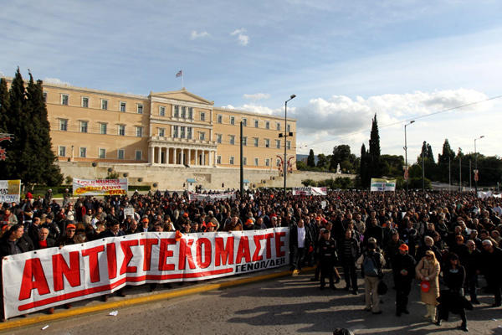
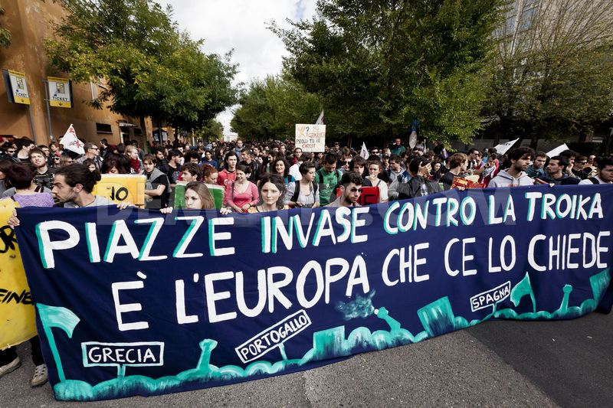
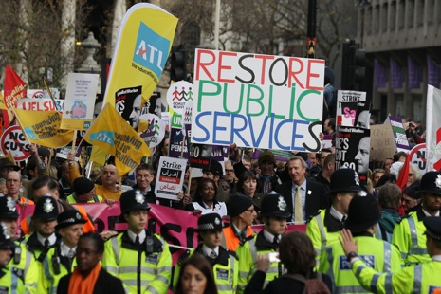
Austerity politics
Notes:
Austerity programmes have been the response in many high income countries to the Global Recession. In 2008, as a response to the financial crisis, many OECD countries spent large amounts of the fiscal budget on rescuing the banking sector. Financial market dynamics then “attacked” many of the currencies where the fiscal deficit was deemed to be “too high” , frightening governments into drastic spending cuts.

Slide 19
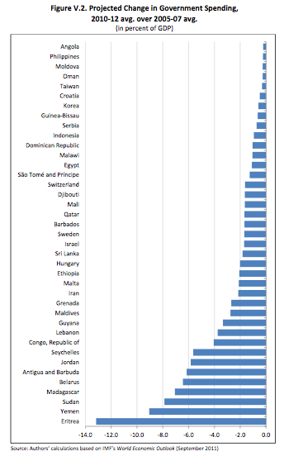
Cuts in budget expenditures
Notes:
The ranking above shows the extent to which low income countries plan to cut fiscal budget expenditures, as a share of GDP, as a result of the global economic crisis – ranging from 0.3% in Angola to 13% in Eritrea . This will mainly and most severely affect low income households, families and children because of the cuts in social expenditures and the knowck-on effects in terms of decreases in employment.
Source: Isabel Ortiz & Matthew Cummins. 2012. A Recovery for all. Rethinking Socio-Economic Policies for Children and Poor Households. UNICEF New York. P. 185. Table V.2

Slide 20
III. The global socio-economic situation

Slide 21
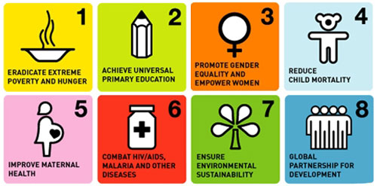

Notes:
Official list of MDG indicators, http://unstats.un.org/unsd/mdg/Host.aspx?Content=Indicators/OfficialList.htm

Slide 22
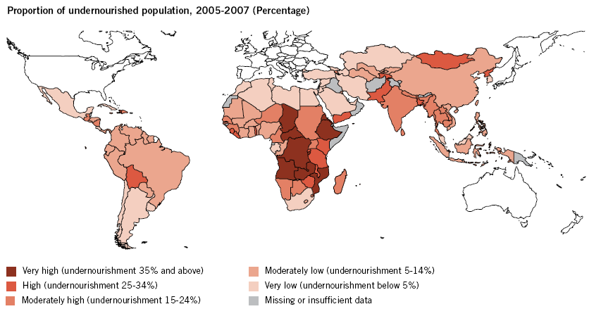
Malnutrition
Notes:
UN: The Millennium Development Report 2011, New York 2011, S.12 http://mdgs.un.org/unsd/mdg/Resources/Static/Products/Progress2011/11-31339%20(E)%20MDG%20Report%202011_Book%20LR.pdf, abgerufen am 27.10.2011

Slide 23
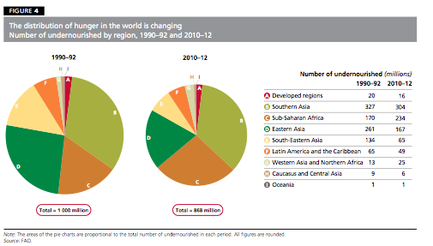
Global hunger
Notes:
Source: FAO-IFAD-WFP. The State of Food Insecurity in the World (SOFI) 2012 report. http://www.fao.org/docrep/016/i3027e/i3027e.pdf

Slide 24
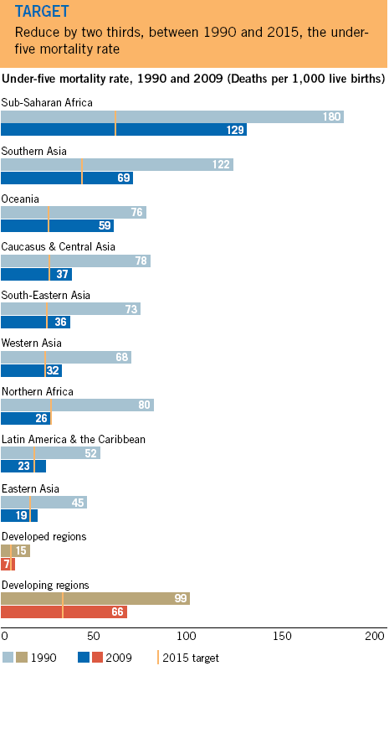
Notes:
UN: The Millennium Development Report 2011, New York 2011, S. 24ff. http://mdgs.un.org/unsd/mdg/Resources/Static/Products/Progress2011/11-31339%20(E)%20MDG%20Report%202011_Book%20LR.pdf, abgerufen am 27.10.2011

Slide 25
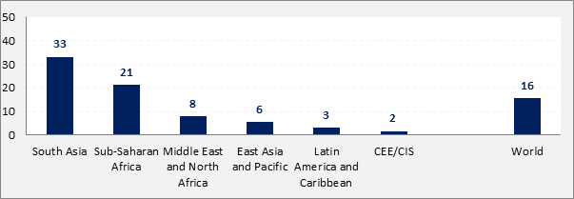
Children under 5: underweight (2011)
Notes:
Children under 5 suffering underweight (low weight for height, a consequence of acute or chronic malnutrition) . Globally, underweight affects 16% of the world´s under-fives. In South Asia as many as one third – in India 45%.
Note: Estimates are calculated according to WHO Child Growth Standards. Source: United Nations Children’s Fund, World Health Organization, The World Bank, UNICEF-WHO-World Bank Joint Child Malnutrition Estimates, 2011 revision (completed July 2012). http://www.childinfo.org/malnutrition_status.html

Slide 26
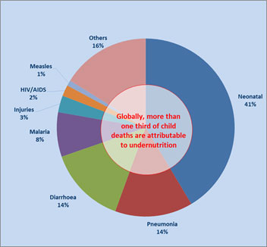
Causes of under-five deaths in 2008
Notes:
Most child deaths are preventable, and the figure shows that more than a third of young child deaths are due to malnutrition, Poverty, low levels of education and poor access to health services are major contributors to childhood under-nutrition, a complex issue that requires tackling on a wide number of fronts.
Source: WHO/Child Health Epidemiology Reference Group (CHERG) estimates presented in The Lancet, June 2010. http://www.childinfo.org/malnutrition.html

Slide 27
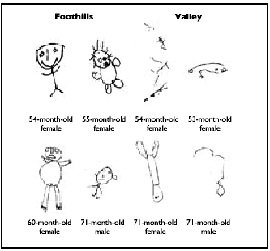
Permanent Damage to Health and Development of Mothers and Children
Rio Yaqui, Mexico May 2006
Notes:
Indigenous Peoples for a Global Toxics Free Future: A Human Rights Framework addressing Environmental Violence and Health of Future Generations. International Indian Treaty Council. Presentation from Rio plus 20 Global Summit.
June 11th, 2012, Rio de Janeiro
People in the valley of the Yaqui River in Mexico are exposed to toxic substances contained in pesticides that are sprayed in this region. The health of mothers and and the development of children is severely affected, as shown in these children's drawings comparing those done by 5-6 year olds in the valley with those done by children living in the foothills.

Slide 28
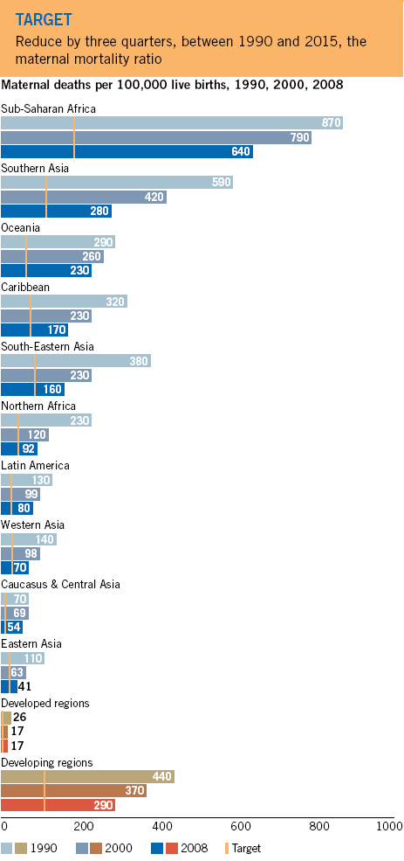
Notes:
UN: The Millennium Development Report 2011, New York 2011, S.28 http://mdgs.un.org/unsd/mdg/Resources/Static/Products/Progress2011/11-31339%20(E)%20MDG%20Report%202011_Book%20LR.pdf, abgerufen am 27.10.2011

Slide 29
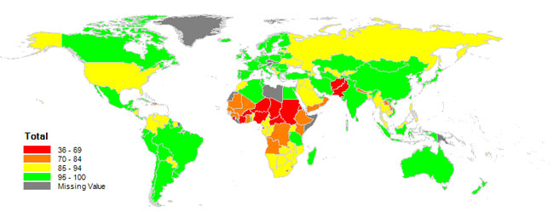
Primary school net enrolment
/net attendance ratio
Notes:
MDG 2 is about schooling, measured in enrolment ratios. School enrolments are among the few MDG indicators that are doing well for the majority of countries. But enrolment or attendance is only about primary schooling, and gives no information on school completion, or the quality of the education received.
14 countries in the world have extreme educational poverty at the primary level; they are in sub-Saharan Africa and South Asia
Notes: Primary net enrolment or attendance ratio. Primary net enrolment data prioritized. Primary net attendance data from surveys were used when primary net enrolment data were not available. This map is stylized and not to scale. It does not reflect a position by UNICEF on the legal status of any country or territory of the delimitation of any frontiers. The dotted line represents approximately the Line of Control in Jammu and Kashmir agreed upon by India and Pakistan. The final status of Jammu and Kashmir has not yet been agreed upon by the parties.
Sources: UNESCO Institute for Statistics, global databases, 2011, based on administrative data, 2009 or latest available. UNICEF global databases, 2011, based on Multiple Indicator Cluster Surveys (MICS), Demographic and Heath Surveys (DHS) and other national household surveys, 2005–2010. http://www.childinfo.org/education_1056.htm

Slide 30
Income poverty
Poverty is often defined as living below a defined national poverty line.
Decreasing poverty by half, measured in the international poverty line, is one of the most cited MDGs.
Notes:
Income poverty is calculated based on the price of a basket of foods required to cover a minimum calorie intake. There are national poverty lines and defining the minimum requirements is highly political, since any increase in the acknowledged minimum raises the number of people statistically recognised as living in poverty.
The $1.25 poverty line used in the MDG discussions is an international poverty line, based on purchasing power parity. It is extremely low.

Slide 31
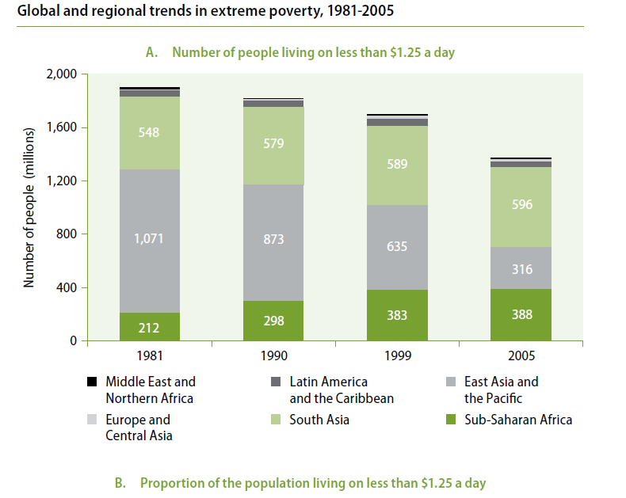

Slide 32
Income poverty
Number of extremely poor in Sub-Saharan Africa and South Asia increased
  using $1.25 per personday income poverty measure
Number of poor and vulnerable people:
  2.5 billion persons
  using $2 per personday income poverty measure
Notes:
However, when looking closely, poverty actually increased in 2 major regions of the world.
And: Using a one-dimensional income poverty indicator, $2 per person per day would be a more realistic poverty line. It shows a large absolute number of the world population under the poverty line, who are highly vulernable to economic, political, household and community or national-level level shocks.
Also, indicators of income distribution have worsened globally, and even in countries where „dollar a day poverty“ has been decreasing, income disparities between the richest and poorest segments of the population – the Gini index – have widened (see UN-WIDER studies on income distribution).

Slide 33
Notes:
Source: …
This is a static picture of the state of income inequality measured by the Gini coefficient (the closer to 1oo, the worse the situation). The figure shows the large differences in income inequality, and that many of the so called emerging economies, considered to be so successful in terms of economic growth, are among the countries with the highest inequalities.
A dynamic picture showing changes over time would reveal the increasing income inequality of the past decade.
Data for latest available year.

Slide 34
IV.) Current international health financing dynamics

Slide 35
New players
Among countries
  New hierarchies and power constellations
Within and across countries:
  increasingly accepted role of the business sector and of private foundations

Slide 36


























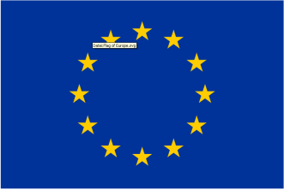




Profusion of actors
Notes:
Dr. Angelika Schrettenbrunner und Lisa Reigl
Global Health und Entwicklungszusammenarbeit im Gesundheitsbereich
Deutsche Gesellschaft für Internationale Zusammenarbeit
Universität Bonn, 09.Oktober 2013

Slide 37
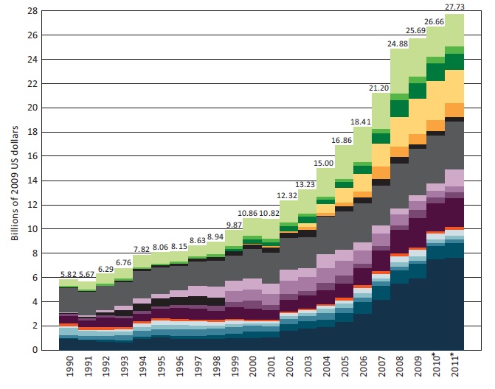
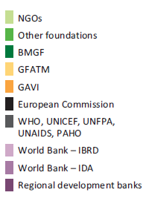
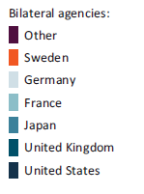

Composition of health financing (1990-2011)
*2010 and 2011 are preliminary estimates based on information from the above organizations, Institute for Health Metrics and Evaluation (IHME), University of Washington: Financing Global Health 2011
Notes:
Source: Angelika Schrettenbrunner und Lisa Reigl
Global Health und Entwicklungszusammenarbeit im Gesundheitsbereich
Deutsche Gesellschaft für Internationale Zusammenarbeit
Universität Bonn, 09.Oktober 2013

Slide 38
Privatised international health sector: selected annual expenditures (2010)
GFATM ca. 3 billion USD
GAVI Alliance ca. 1 billion USD
World Vision 2,48 billion USD
OXFAM 911 million €
Doctors without borders (MSF) 813 million €
ICRC 808 million €
Care International 580 million €;
Welthungerhilfe 185 million €
Misereor 184 million €
EED 168 million €
„Global Health is a multi-billion dollar industry …“
(David McCoy et al. 2009)
Notes:
Source: Angelika Schrettenbrunner und Lisa Reigl
Global Health und Entwicklungszusammenarbeit im Gesundheitsbereich
Deutsche Gesellschaft für Internationale Zusammenarbeit
Universität Bonn, 09.Oktober 2013

Slide 39
Exercise I:
Inequities in access to health
  In light of the impact of globalisation, and the trends in political, social and economic situations:
  In your country: what are the inequities in access, quality, inclusiveness, coverage, and affordability of health services (list out individually) (5 minutes)
    Compare notes with your neighbour: are there common types of inequities (discuss in pairs)
    (5 minutes)
    What are the 3 most pressing issues? (present & discuss findings in plenary) (10 minutes)

Slide 40
V. Equity – versus social exclusion, lack of decent, low social protection coverage

Slide 41
Promoting equity, equality and inclusion
Equality is the principle that all human beings are equal and have equal rights
Equity is a principle that refers to fairness of treatment according to needs and specific requirements.
Notes:
This means that a policy may be equitable – equal coverage across all districts, or equal coverage per person, but may not be equitable, because for some individuals or communities access may be more cumbersome, more expensive, or socially more daunting. Equity is a principle within a universalist, citizenship- and rights-based approach whereby special measures are in place to ensure that those individuals, households or identity groups who are disadvantaged are put into a position to claim their rights and have access to basic income and high-quality social services.

Slide 42
Social exclusion undermining equity
Systematic exclusions are the result of the intersecting inequalities
Social exclusion
Cultural inequalities
Spatial inequalities
Economic inequalities
Political inequalities
The interaction of the exclusions explains the persistence of social exclusion over time. ( Naila Kabeer)
Notes:
Cultural inequalities: forms of discrimination and devaluation that treat members of these groups as of
lesser status and worth than others
Spatial inequalities: such groups frequently live in places that make them harder to reach or easier to
Ignore
Economic inequalities: they are at the receiving end of an unfair distribution of assets and opportunities
Political inequalities: they are deprived of voice and influence in the decisions that affect their lives and
their communities
(Naila Kabeer. Can the MDGs provide a pathway to social justice? The challenge of intersecting inequalities)

Slide 43

Vectors of social exclusion
  Income/economic class/ access to productive assets
  Caste/clan
  Ethnicity
  Faith
  Language
  Health condition/communicable/visible diseases
  Ability/disability
  Geographic location/”distance”/urban vs rural
  Citizenship and migration status
  Condition of menstruation
  Sexual orientation
  Recurrent emergency situations
  Conflict situation
  Age
GENDER
Notes:
The academic and applied literature and my own empirical analysis suggest that social exclusion along the vectors of gender, caste, ethnicity, religious affiliation, language group, disability, geographical location, age, and other vectors is a key reason for poor MDG performance.

Slide 44
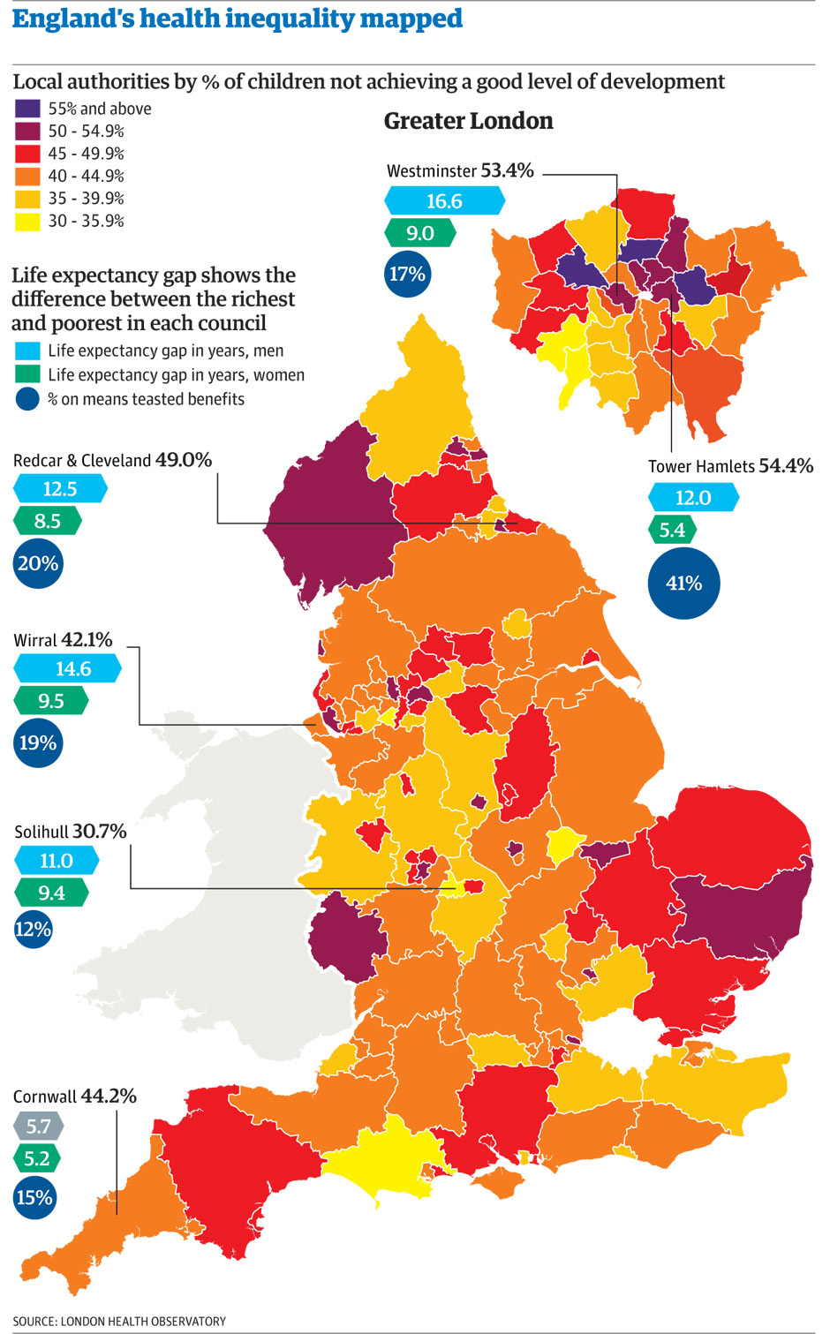
Notes:
Disparities within a high-income country – health outcomes in the UK vary significantly across regions, measured here in child development outcomes – purple and red signify 45 or more % of children not achieving a good level.
Source: London health observatory

Slide 45
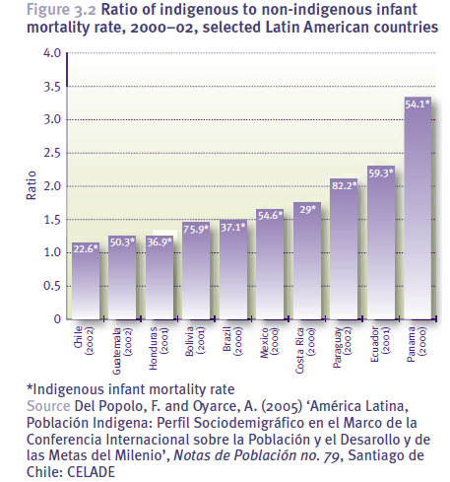

Slide 46
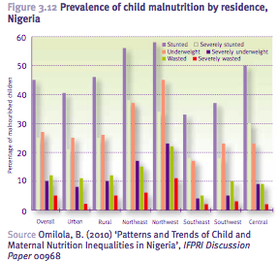

Slide 47
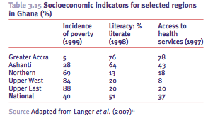

Slide 48
Myanmar: Socio-economic and regional disparities in skilled attendance at birth delivery
Regional disparities
Notes:
Source MICS 2009-2010 UNICEF Myanmar.
The situation in the various regions is quite disparate, with better situations in the old capital Yangon and on the borders with Thailand, and the worst in the predominantly ethnic minority areas. Everywhere, poorer women are less likely to give birth with a skilled attendant than the richest-quintile women.

Slide 49
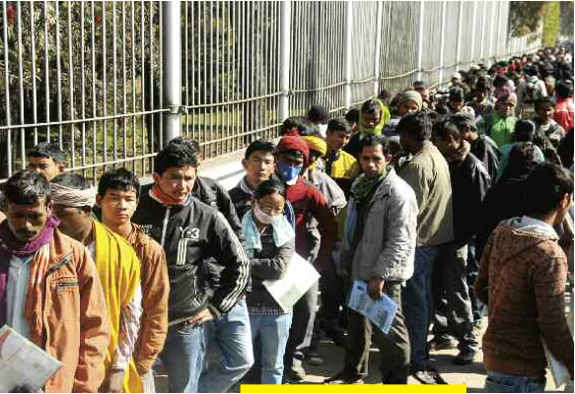
Lack of decent work
Notes:
Photo: Men and women queue for passport applications at the Ministry of Foreign Affairs in Kathmandu, Nepal – presumably many among them are distress migrants.
© chandra Shekhar Karki
Source: Amnesty International. 2011. FALSE PROMISES . Exploitation and forced labour of Nepalese migrant workers. London. 2011.
http://www.amnesty.org/en/library/asset/ASA31/007/2011/en/b58f0185-455d-425c-bc4f-d6b7fe309524/asa310072011en.pdf

Slide 50
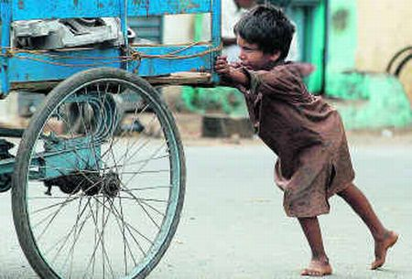
Child labour
Notes:
Child labour affects millions of children globally, some as young as 5 years. There is an ILO Convention on Minimum Age, and another one of the worst forms of child labour, that apply. But these are far from sufficient in reality and as long as adults do not make a decent living from their work, women are not equal, and there are massive forms of social exclusion, child labour cannot be tackled.

Slide 51
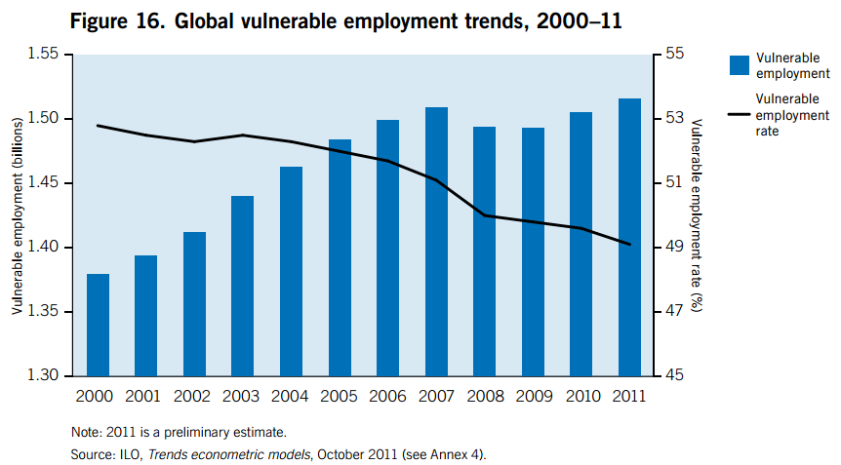
“Vulnerable” employment
Notes:
Source: ILO 2012
Highest shares of vulnerable employment in South Asia – 78.5%, Subsaharan Africa – 75.8%, and Southeast Asia and Pacific – 61.8% ILO 2012: 22).
-
The “vulnerable employment” indicator, defined as the sum of own-account workers and unpaid family workers, provides valuable insights into trends in overall employment quality, as a high share of workers in vulnerable employment indicates widespread informal work arrangements, whereby workers typically lack adequate social protection and social dialogue mechanisms. Vulnerable employment is also often characterized by low pay and difficult working conditions in which workers’ fundamental rights may be undermined. (ILO, Global Employment Trends 2011. The challenge for a jobs recovery, 2011: 21 f) The vulnerable employment indicator is one of the official Millennium Development Goals (MDG) employment indicators, under “Goal 1: Eradicate extreme poverty and hunger”, together with the employment-to-population ratio, labour productivity growth rate and the share of the working poor in total employment. For a full list of indicators, see: http://unstats.un.org/unsd/mdg/Host.aspx?Content=Indicators/OfficialList.htm. The MDG employment indicators are described in detail in ILO: Guide to the new Millennium Development Goals Employment Indicators (Geneva, 2009); http://www.ilo.org/wcmsp5/groups/public/---ed_emp/documents/publication/wcms_110511.pdf. 23).
As noted in the Global Employment Trends 2010 report, the vulnerable employment indicator has some limitations: (1)wage and salary employment is not synonymous with decent work, as workers may carry a high economic risk despite the fact that they are in wage employment; (2) the unemployed are not included in the indicator, though they are vulnerable; (3) a worker may be classified in one of the two vulnerable status groups but still not carry a high economic risk, especially in the developed economies.

Slide 52
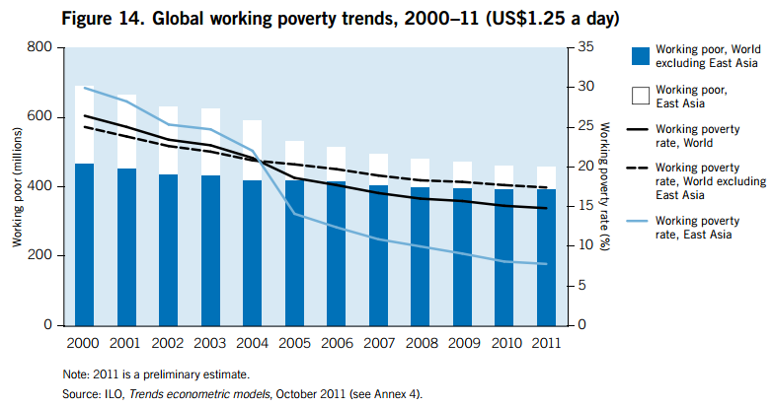
Working poverty trends
Notes:
One in 5 people working are estimated to be living in extreme poverty., defined as less than $1.25 per person per day (ILO 2012: 41).
The working poor are defined by the ILO as those who work and belong to poor households (Majid, Nomaan. 2001.“The size of the working poor population in developing countries”. Employment Paper 2001/16. (Geneva, ILO).
The first ILO estimates of working poverty were published in 2000 by Nomaan Majid as background work for the 2001 World Employment Report and included the aggregate numbers of working poor in the world and by region for 1986 and 1997. In 2002, Stefan Berger and Claire Harasty produced new estimates of working poverty for the years 1990 and 2000 and also estimated the GDP growth needed to reduce by half the share of working poor in total employment between 2000 and 2010. (Kapsos, Steven. 2004. “Employment Strategy Papers Estimating growth requirements for reducing working poverty: Can the world halve working poverty by 2015?”. Employment Paper 2004/14. (Geneva ILO).)

Slide 53
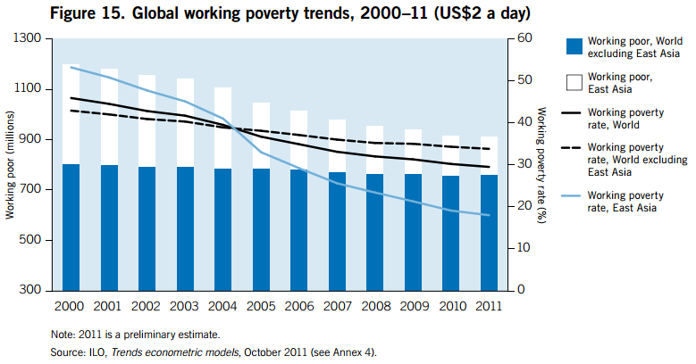
Working poverty trends
Notes:
The working poor are defined by the ILO as those who work and belong to poor
households (Majid, Nomaan. 2001.“The size of the working poor population in developing countries”. Employment Paper 2001/16. (Geneva, ILO).
The first ILO estimates of working poverty were published in 2000 by Nomaan Majid as background work for the 2001 World Employment Report and included the aggregate numbers of working poor in the world and by region for 1986 and 1997. In 2002, Stefan Berger and Claire Harasty produced new estimates of working poverty for the years 1990 and 2000 and also estimated the GDP growth needed to reduce by half the share of working poor in total employment between 2000 and 2010. (Kapsos, Steven. 2004. “Employment Strategy Papers. Estimating growth requirements for reducing working poverty: Can the world halve working poverty by 2015?”. Employment Paper 2004/14. (Geneva ILO).)

Slide 54
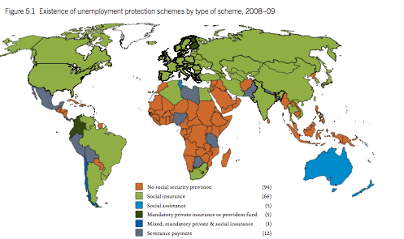
Social protection in case of unemployment
Notes:
Source ILO World Social Security Report 2010 p 58

Slide 55
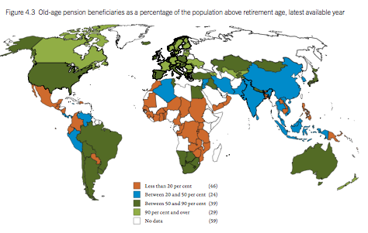
Old age pension coverage
Notes:
Source ILO World Social Security Report 2010 p 47

Slide 56
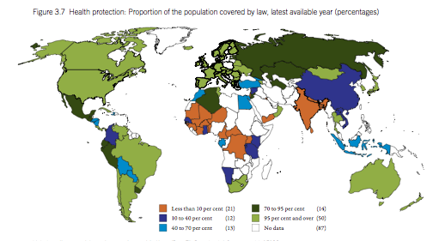
Health protection – legal provision
Notes:
Source ILO World Social Security Report 2010 p 41

Slide 57
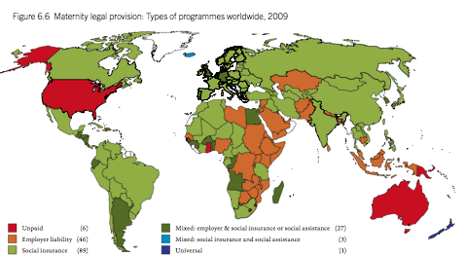
Maternity benefits
Notes:
Source ILO World Social Security Report 2010 p 70

Slide 58
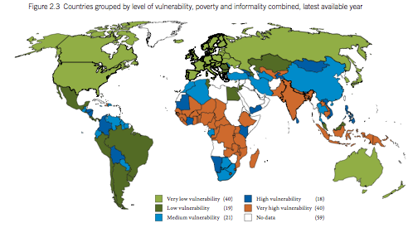
Vulnerability, poverty, informality
Notes:
Source ILO World Social Security Report 2010 p 31

Slide 59
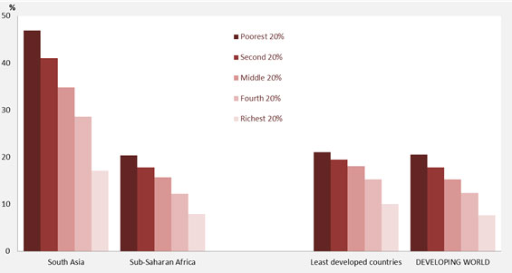
Children under 5: underweight by wealth quintile
Notes:
This figure shows the direct connection between income poverty and malnutrition and underweight conditions of young children.
Note: Analysis is based on a subset of 61 countries with household wealth quintile information, covering 53 per cent of the under-five population in the developing world. Prevalence estimates are calculated according to WHO Child Growth Standards, 2006–2010. CEE/CIS, East Asia and the Pacific, Latin America and the Caribbean and the Middle East and North Africa are not included due to lack of data coverage.
Source: UNICEF global databases, from MICS, DHS and other national surveys, 2006–2010. http://www.childinfo.org/malnutrition_status.html

Slide 60
Impact of Social Exclusion
MDG outcomes perform worse among socially excluded groups – these groups need special measures to enable them to claim their rights to social services and public goods
Disparities based on social exclusion must be made more visible
Policies to address the inequities resulting from exclusion are needed

Slide 61
VI.) Normative positions and equity

Slide 62
Universal Declaration of Human Rights (UDHR) (1948)
“The inherent dignity of all members of the human family is the foundation of freedom, justice and peace in the world”
Human rights are universal and are to be enjoyed by all people, no matter who they are or where they live.
UDHR includes:
  civil and political rights, such as the right to life, liberty, free speech and privacy.
  Economic, social and cultural rights such as the right to social security, health and education.
Notes:
The Universal Declaration of Human Rights was adopted at the UN General Assembly in 1948, as discussed above. It posits the universality of rights, and emphasises dignity as well as economic and social wellbeing. A key notion was the freedom from fear and freedom from want. See Gabriele Koehler 2012.
Full UDHR can be found at http://www.un.org/en/documents/udhr/

Slide 63
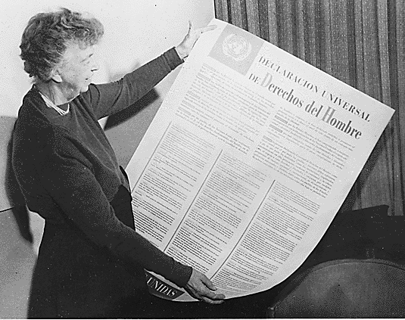
Universal Declaration of Human Rights
Notes:
Eleanor Roosevelt, one of the drafters of the UDHR, holding up a first copy.
http://upload.wikimedia.org/wikipedia/commons/d/d4/EleanorRooseveltHumanRights.png
The drafting committee had 9 members, and was chaired by Eleanor Roosevelt (US): Dr. Charles Malik (Lebanon); Alexandre Bogomolov (USSR); Dr. Peng-chun Chang (China):René Cassin; Charles Dukes (United Kingdom); William Hodgson (Australia); Hernan Santa Cruz (Chile); John P. Humphrey (Canada)
In her memoirs, Eleanor Roosevelt recalled: “Dr. Chang was a pluralist and held forth in charming fashion on the proposition that there is more than one kind of ultimate reality. The Declaration, he said, should reflect more than simply Werstern ideas and Dr. Humphrey would have to be eclectic in his approach. His remark, though addressed to Dr. Humprhey, was really directed at Dr. Malik, from whom it drew a prompt retort as he expounded at some length the philosophy of Thomas Aquinas. Dr. Humphrey joined enthusiastically in the discussion, and I remember that at one point Dr. Chang suggested that the Secretariat might well spend a few months studying the fundamentals of Confucianism!” http://www.un.org/en/documents/udhr/history.shtml

Slide 64
Covenants (1966)
International Covenant on Economic, Social and Cultural Rights (1966) commits its parties to work toward the granting of labour rights, the right to social security, family life, adequate standard of living, health, free education and participation in cultural life:
“The ideal of free human beings enjoying freedom from fear and want can only be achieved if conditions are created whereby everyone may enjoy his economic, social and cultural rights, as well as his civil and political rights”
International Covenant on Political and Civil Rights (1966) commits its parties to respect the civil and political rights of individuals, including the right to life, freedom of religion, freedom of speech, freedom of assembly, electoral rights and rights to due process and fair trial.
Notes:
Almost 20 years after the UDHR finally 2 Covenants spelling out in more detail the human rights agenda were adopted. They were marked by the East West conflict. The Eastern bloc put emphasis on economic and social conditions while the Western bloc emphasised human rights. But the 2 domains belong together, and one cannot establish a hierarchy.
Full ICESCR can be found here: http://www2.ohchr.org/english/law/cescr.htm
Full ICCPCR can be found here: http://www2.ohchr.org/english/law/ccpr.htm

Slide 65
Convention on Elimination of
All Forms of Racial Discrimination (CERD) (1969)
commits its members to the elimination of racial discrimination, promotion of understanding among all races, condemnation of apartheid, outlawing hate speech, dispute resolution and individual complaint mechanisms:
“Convinced that any doctrine of superiority based on racial differentiation is scientifically false, morally condemnable, socially unjust and dangerous, and that there is no justification for racial discrimination, in theory or in practice, anywhere (…) the existence of racial barriers is repugnant to the ideals of any human society”
Notes:
In the same period, the UN succeeded in adopting the CERD. It is the least cited of all UN Conventions – although discrimination is at the heart of social exclusion, poverty, and the violation of child rights.
Full text can be found here: http://www2.ohchr.org/english/law/cerd.htm

Slide 66
Convention on the Eradication of
All Forms of Discrimination against Women (CEDAW) (1979)
commits its parties to enshrine gender equality in their domestic legislation, repeal all discriminatory provisions in their laws, enact new provisions to guard against discrimination against women
“…the full and complete development of a country, the welfare of the world and the cause of peace require the maximum participation of women on equal terms with men in all fields.”
Notes:
Only after another decade was the CEDAW adopted. It is interesting to note that gender equality as a concept received consensus over a convention so much later than racial equality.
Full text can be found here: http://www.un.org/womenwatch/daw/cedaw/text/econvention.htm

Slide 67
The Convention on the
Rights of the Child (CRC) (1989)
commit its parties to ensure a child’s survival, development, protection and participation rights:
“In all actions concerning children, whether undertaken by public or private social welfare institutions, courts of law, administrative authorities or legislative bodies, the best interests of the child shall be a primary consideration.”
Notes:
And yet another decade passed before children see their rights adopted in a Convention. The CRC came 40 years after the UDHR.
Full text can be found here: http://www2.ohchr.org/english/law/crc.htm

Slide 68
Convention on the Rights of Persons with Disabilities (CRPD) (2006)
Article 1 - The purpose of the present Convention is to promote, protect and ensure the full and equal enjoyment of all human rights and fundamental freedoms by all persons with disabilities, and to promote respect for their inherent dignity.
:
Article 25 – Health
States Parties recognize that persons with disabilities have the right to the enjoyment of the highest attainable standard of health without discrimination on the basis of disability. States Parties shall take all appropriate measures to ensure access for persons with disabilities to health services that are gender-sensitive, including health-related rehabilitation.
Notes:
CONVENTION on the RIGHTS of PERSONS with DISABILITIES
Persons with disabilities include those who have long-term physical, mental, intellectual or sensory impairments which in interaction with various barriers may hinder their full and effective participation in society on an equal basis with others.
http://www.un.org/disabilities/convention/conventionfull.shtml

Slide 69
Declaration on the Rights of Indigenous Peoples (2007)
Article 1
Indigenous peoples have the right to the full enjoyment, as a collective or as individuals, of all human rights and fundamental freedoms as recognized in the Charter of the United Nations, the Universal Declaration of Human Rights4 and international human rights law.
Article 21
1. Indigenous peoples have the right, without discrimination, to the improvement of their economic and social conditions, including, inter alia, in the areas of education, employment, vocational training and retraining, housing, sanitation, health and social security.
2. States shall take effective measures and, where appropriate, special measures to ensure continuing improvement of their economic and social conditions. Particular attention shall be paid to the rights and special needs of indigenous elders, women, youth, children and persons with disabilities.
Notes:
United Nations Declaration on the Rights of Indigenous Peoples. Resolution adopted by the General Assembly 61/295.
http://www.un.org/esa/socdev/unpfii/documents/DRIPS_en.pdf

Slide 70
Normative frameworks: recent UN trends
Global Social Floor
lobbying since 2001 –
ILO Recommendation on Social Protection for all. Rec 202 (ILC June 2012)
World Health Assembly 2008 - return to Alma Ata vision of primary health care for all
Right to food, FAO Committee on World Food Security, May 2012 adopted Voluntary Guidelines on the Responsible Governance of Tenure of Land, Fisheries and Forests in the Context of National Food Security
Notes:
There are also encouraging developments internationally in UN fora in terms of a rights-based agenda – examples include decisions of the governing bodies of the FAO and WHO, and the movement for an international recommendation at the ILO on social protection for all.
In May 2012, Voluntary Guidelines seek to improve governance of tenure of land*, fisheries and forests adopted. “They seek to do so for the benefit of all, with an emphasis on vulnerable and marginalized people, with the goals of food security and progressive realization of the right to adequate food, poverty eradication, sustainable livelihoods, social stability, housing security, rural development, environmental protection and sustainable social and economic development. All programmes, policies and technical assistance to improve governance of tenure through the implementation of these Guidelines should be consistent with States’ existing obligations under international law, including the Universal Declaration of Human Rights and other international human rights instruments. “http://www.fao.org/nr/tenure/voluntary-guidelines/en/
A more rights-based understanding of the MDGs is also emerging, and the role of the OHCHR deserves special mention as the reports of the special rapporteurs/experts are well researched, independent but engaged and critical analyses, and becoming increasingly influential.

Slide 71
Normative frameworks: recent UN trends
MDGs 2010: more emphasis on equity, inclusion, human rights
OHCHR Special rapporteurs on human rights – including right to food and right to highest attainable standards of health
Rio + 20 Summit: outcome document: The Future We Want discusses poverty, social protection
Secretary-General´s Report 2013
Notes:
There are also encouraging developments internationally in UN fora in terms of a rights-based agenda – examples include decisions of the governing bodies of the FAO and WHO, and the movement for an international recommendation at the ILO on social protection for all.
In May 2012, Voluntary Guidelines seek to improve governance of tenure of land*, fisheries and forests adopted. “They seek to do so for the benefit of all, with an emphasis on vulnerable and marginalized people, with the goals of food security and progressive realization of the right to adequate food, poverty eradication, sustainable livelihoods, social stability, housing security, rural development, environmental protection and sustainable social and economic development. All programmes, policies and technical assistance to improve governance of tenure through the implementation of these Guidelines should be consistent with States’ existing obligations under international law, including the Universal Declaration of Human Rights and other international human rights instruments. “http://www.fao.org/nr/tenure/voluntary-guidelines/en/
A more rights-based understanding of the MDGs is also emerging, and the role of the OHCHR deserves special mention as the reports of the special rapporteurs/experts are well researched, independent but engaged and critical analyses, and becoming increasingly influential.

Slide 72
OHCHR Special Rapporteurs/Independent Experts on human rights
  right to education;
  human rights and extreme poverty;
  right to food;
  right to adequate housing;
  access to safe drinking water and sanitation;
  against violence against women;
  physical and mental health;
  access to care;
  economic policies and debt;
  TNCs;
  and other substantive normative areas.
Notes:
What is especially relevant here: the 2011 report of the special rapporteur on HR and extreme poverty made a very strong case for social protection.
“The mission of the Office of the High Commissioner for Human Rights is to protect and promote human rights for all. OHCHR aims to ensure implementation of universally recognized human rights norms, strengthen the United Nations human rights programme, and provide the United Nations treaty monitoring bodies and special mechanisms established by the Commission on Human Rights with the highest support.” Office of the High Commissioner for Human Rights: http://www.un-ngls.org/spip.php?page=article_s&id_article=827
Special Rapporteurs and independent experts are a „special procedures“ mechanism of the OHCHR. They are playing an increasingly prominent role and are moving from more legally-oriented themes to economic and social development. The list includes:
on extrajudicial, summary or arbitrary executions (1982)
on freedom of religion or belief (1986-)
on the sale of children, child prostitution and child pornography (1990-)
on contemporary forms of racism, racial discrimination, xenophobia and related intolerance (1993-)
on the promotion and protection of the right to freedom of opinion and expression (1993-)
on violence against women, its causes and consequences (1994-)
on the independence of judges and lawyers (1994-)
on torture and other cruel, inhuman or degrading treatment or punishment (1995-)
on the adverse effects of the illicit movement and dumping of toxic and dangerous products and wastes on the enjoyment of human rights (1995-)
on the right to education (1998-)
on the question of human rights and extreme poverty (1998-)
on adequate housing as a component of the right to an adequate standard of living (2000-)
on the right to food (2000-)
on the right of everyone to the enjoyment of the highest attainable standard of physical and mental health (2002-)
of the Secretary-General on the situation of human rights defenders (2000-)
on the situation of human rights and fundamental freedoms of indigenous people (2001-)
of the Secretary-General on the human rights of internally displaced persons (2004-)
on the human rights of migrants (1999-)
on minority issues (2005-)
on human rights and international solidarity (2005-
on the effects of economic reform policies and foreign debt on the full enjoyment of human rights, particularly economic, social and cultural rights (2000-)
on the promotion and protection of human rights while countering terrorism (2005-)
on trafficking in persons, especially in women and children (2004-)
on human rights and transnational corporations and other business enterprises (2005-)
international solidarity or minority issues in (2005)
water and sanitation (2008)
TNCs (2009).
In 2010, there were 41 Special Procedures (33 thematic mandates and eight mandates relating to countries or territories) with currently 55 mandate holders. See OHCHR Facts and Figures 2010.

Slide 73
The “decent work” agenda
  Productive employment
  Core labour standards
  Social dialogue
  Rights-based
Notes:
Source: ILO, A Global Jobs Pact. Recovering from the crisis. Adopted by the International Labour Conference at its 98th session, Geneva, 19 June 2009.ILO Geneva. See page V
Fundamental conventions: freedom of association, right to organise, collective bargaining, social security minimum wage,

Slide 74
ILO’s two-dimensional strategy for the extension of social security:
Building comprehensive social security systems
  Vertical dimension: progressively ensuring
  higher levels of protection, guided by Convention No.102
  and more advanced standards
high
Voluntary insurance
under government regulation
level of protection
Social security benefits
of guaranteed levels
floor level
Social Protection Floor:
Access to essential health care
and basic income security for all
low
low
individual/household income
high
Outcomes can be guaranteed through different means
  Horizontal dimension:
  Guaranteeing access to essential health care
  and minimum income security for all,
  guided by Recommendation No. 202

Slide 75
ILO’s two-dimensional strategy for the extension of social security:
Building comprehensive social security systems
high
extension strategy
Voluntary insurance
under government regulation
  Vertical dimension: progressively ensuring
  higher levels of protection, guided by Convention No.102
  and more advanced standards
level of protection
Social security benefits
of guaranteed levels
floor level
Social Protection Floor:
Access to essential health care
and basic income security for all
low
low
individual/household income
high
Outcomes can be guaranteed through different means –
there is
no one-size-fits-all
Social Protection Floor Recommendation, adopted at ILC 2012
  Horizontal dimension:
  Guaranteeing access to essential health care
  and minimum income security for all,
  guided by Recommendation No. 202

Slide 76
G20 Seoul development consensus action points
infrastructure,
private investment and job creation,
human resource development,
trade,
financial inclusion,
growth with resilience,
food security,
domestic resource mobilization,
knowledge sharing
Principles:
highlight human rights
but reliance on economic growth
Notes:
Source Seoul consensus 2010. G20 Seoul Summit. http://media.seoulsummit.kr/contents/dlobo/E3._ANNEX1.pdf
In 2010, the G20, meeting in the Republic of Korea, adopted a development strategy. Interesting here the prominent role accorded to economic infrastructure, seen by many to have been neglected in the MDGs agenda. The points on job creation, human resource development and growth with reslilience - which is largely about social protection –can be seen as a deepening of the MDGs on employment, youth employment, and education.
Finally food security has gained the prominence it deserves.
However, the Seoul consensus is built on a ideology of private sector led growth, which surprises since the MICs among the G20 countries had growth strategies that relied heavily on the developmental state.

Slide 77
  G20 – Cannes final declaration (2011)
    Global strategy for growth and jobs
      Employment and social protection
    More stable & resilient international monetary system
    Deepening financial sector reforms
    Addressing food price volatility, increasing agricultural productivity
    Improving functioning of energy markets
    Pursuing fight against climate change
    Reinforcing multilateral trading system
    Development: investing for global growth
    Fight against corruption
    Intensifying fight against corruption
    Governance
Notes:
G20 Summit closed with a Final Declaration. Cannes. 4 November 2011: „Building our common future: Renewed collective action for the benefit of all“
http://www.g20.org/pub_communiques.aspx

Slide 78
BRICS DELHI DECLARATION 2012
28. Accelerating growth and sustainable development, along with food, and energy security, are amongst the most important challenges facing the world today, and central to addressing economic development, eradicating poverty, combating hunger and malnutrition in many developing countries. Creating jobs needed to improve people's living standards worldwide is critical. Sustainable development is also a key element of our agenda for global recovery and investment for future growth. We owe this responsibility to our future generations.
Notes:
BRICS: Brazil, Russia, India, China, South Africa. Originally conceptualised as a grouping of rapid growth by an investment firm, BRICS now meet at heads of state and technical level to discuss common policy stances.
Delhi Summit 2012 prepared a report with a chapter on major achievements - one of which the cash transfer programmes of Brazil.

Slide 79
VII.) Outlook: development agenda beyond 2015

Slide 80
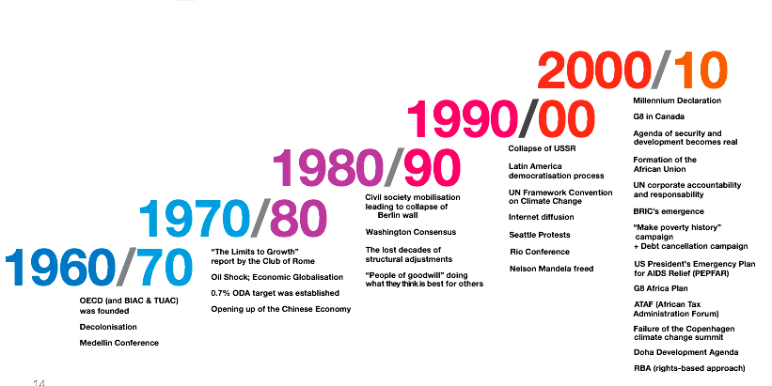
Development decades
Notes:
OECD Idea Factory 2011. New Paradigms for Development snapshots from a co-operation experiment inside the OECD Forum 2011
http://www.oecd.org/dataoecd/56/17/48785383.pdf

Slide 81
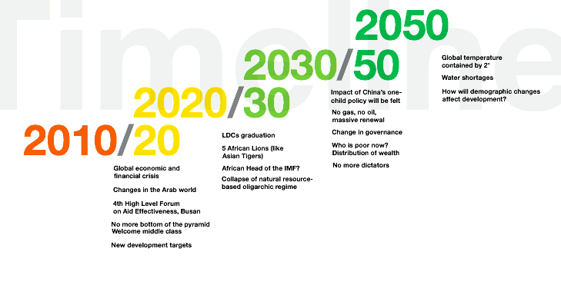
Development decades
Notes:
OECD Idea Factory 2011. New Paradigms for Development snapshots from a co-operation experiment inside the OECD Forum 2011
http://www.oecd.org/dataoecd/56/17/48785383.pdf

Slide 82
Beyond 2015: re-inventing “development”
human rights dimensions, human dignity, and choice
income and and wealth inequalities
social exclusion and poverty in multidimensional mode
applicable to all societies
all MDGs– food, employment, poverty, education, child & maternal health, HIV-Aids etc, gender equality, environment
violence and conflict
ecological destruction and climate change
subjective perceptions
political and personal security
“bottom up” participatory decision making
employment/decent work and asset access/social protection
policy focus+ : ”heterodox”; from the South
good governance
solidarity
universalism/social contracts
domestic resource mobilisation
Notes:
Source: building on Melamed 2011; Koehler, Gasper, Jolly, Simane 2011

Slide 83
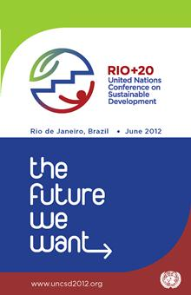
Notes:
In 2015, the MDG agenda will be reviewed and either extended, deepened or replaced. The innovations need to come from the South and build on the progressive, rights based policy orientation of many “developing countries”, to create a genuinely rights based agenda for global development in South and North.
So there is a new discourse emerging – in connection with the Rio + 20 conference of the UN system:
there is a proposal to introduce Sustainable or Global Development Goals to either complement or replace the MDGs.
Some advocates speak of “occupying Rio + 20” in the sense of setting the agenda and outcomes.
One will need to find a good multidimensional concept. Ideas to inject into the discussions – which need to be led by the South - include, inter alia:
the notion of human security, building on the ideas of promoting freedom from fear and freedom from want, which evolved into key domains of human security – food and nutrition, income and employment, health, education, access to water and sanitation, political security, social inclusion – and a combination of objective factors of human security and subjective plane of perceptions; or
the notion of “3-dimensional wellbeing” conceptualised by Sumner and McGregor; or
“MDGs plus”; and
SDGs
GDGs
Other ideas.

Slide 84
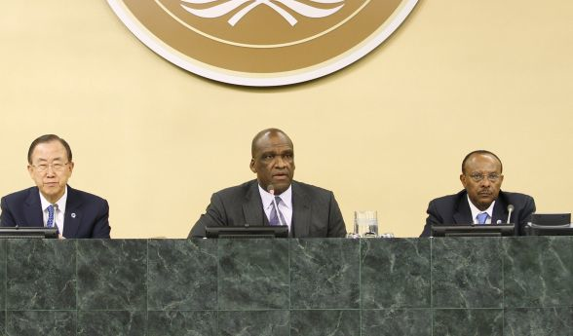
UN General Assembly session on MDGs September 2013
Notes:
The special session was devoted to progress on the MDGs, effort needed to attain them and designing a road map towards a new agenda that is sustainable – as demanded by the RIO plus 20 process, and stays in the spirit of the MDGs, but fills their gaps.
http://fnnewyork.um.dk/en/~/media/fnnewyork/English/Images/Front-page-slider/General%20Assembly%20Opens%2068th%20Session_588px.jpg

Slide 85
SDGs/MDGs beyond 2015:
“five transformative shifts”
1. Leave no one behind.
2. Put sustainable development at the core.
3. Transform economies for jobs and inclusive growth.
4. Build peace and effective, open and accountable institutions for all.
5. From vision to action.
Notes:
Source A NEW GLOBAL PARTNERSHIP: ERADICATE POVERTY AND TRANSFORM ECONOMIES THROUGH SUSTAINABLE DEVELOPMENT
The Report of the High-Level Panel of Eminent Persons on the Post-2015 Development Agenda.

Slide 86
Discussions for post 2015
Country consultations (2012-13)
One million opinions collected in consultations, face-to-face and via the internet (2012-13)
UN interagency task team report (2013)
High level panel report to the UN Secretary-General (2013)
UN Secretary-General’s Report to the General Assembly. Life in Dignity for All (2013)

Slide 87
Visioning a future „development“ policy
Reflecting on changing realities
Combining „Rio plus 20“ and the MDG process – sustainable development
the integration of economic growth, social justice and environmental stewardship
But go further:
Towards equitable, participatory, transformative human development strategies - with health for all as a core principle

Slide 88
Exercise II:
Health policies and inequities
    Based on the access issues identified for your country (exercise I), and in light of international norms, and the emerging new development agenda
    List out policy ideas for equity in access to health services
      individually (5 minutes)
    Compare notes with your neighbour and choose 3 crucial policies
      discuss in pairs (5 minutes)
    Present and discuss in plenary (10 minutes)

Slide 89
References/reading suggestions 1:
Sabine Alkire 2011, Oxford Poverty & Human Development Initiative OPHI. OPHI – HDCA Summerschool 2011 Oxford Department of International Development. Queen Elizabeth House, University of Oxford. http://www.ophi.org.uk/teaching/short-courses/2011-summerschool/
Michelle Bachelet 2011. Social protection floor for a fair and inclusive globalization. Report of the Advisory Group chaired by Michelle Bachelet Convened by the ILO with the collaboration of the WHO. ILO 2011. www.ilo.org
Jomo, KS ed, 2006, Globalization under Hegemony. The Changing World Economy. Oxford: OUP
Richard Jolly, Louis Emmerij, Thomas Weiss 2001, Ahead of the Curve? UN ideas and global challenges. Indiana University Press
Naila Kabeer, Can the MDGs provide a pathway to social justice. The challenge of intersecting inequalities. IDS and UN MDG Achievement Fund. 2010. www.ids.ac.uk
Gabriele Koehler, Deepta Chopra, eds. Development and Welfare Policy in South Asia. London. Routledge – February 2014. http://www.taylorandfrancis.com/catalogs/environment_and_sustainability/1/2/;
Gabriele Köhler. How to get to a genuinely new agenda for equity and human dignity for all? Holding Governments Accountable to a Vision for "Post 2015". Recovery with a human face. http://networkideas.org/news/sep2013/news25_Post_2015.htm; http://gabrielekoehler.net/1home.aspx
Gabriele Köhler, Policies towards social inclusion. Global Social Policy. April 2009: pp. 24-29, Sage publications
Gabriele Köhler, Des Gasper, Richard Jolly, Mara Simane 2012. Deepening the MDGs: human security. Journal on Human Security. http://www.janp.sfc.keio.ac.jp/JAHSS/journals/JOHSR_vol1-2.pdf
Gabriele Köhler, Policies towards social inclusion. Global Social Policy. April 2009: pp. 24-29, Sage publications
Jens Martens, 2011, Thinking ahead. Development Models and Indicators of Well-being Beyond the MDGs. Friedrich Ebert Foundation and Global Policy Forum Europe.www.fes-globalization.

Slide 90
References/reading suggestions 2:
Robert Marten, Jan Martin Witte 2008, Transforming Development? The role of philanthropic foundations in international development cooperation. Global Public Policy Institute. GPPi Research Paper Series No. 10 (2008) www.gppi.net. Accessed 25 Nov 2010
Dane Rowlands 2008. Emerging Donors in International Development Assistance: A Synthesis Report. Norman Paterson School of International Affairs. Carleton University. http://www.idrc.ca/uploads/user-S/12447280141Synthesis_Report.pdf. Accessed 25 Nov 2010
Angelika Schrettenbrunner und Lisa Reigl. Global Health und Entwicklungszusammenarbeit im Gesundheitsbereich. Deutsche Gesellschaft für Internationale Zusammenarbeit. Universität Bonn, 09.Oktober 2013
UN General Assembly, 2010, Outcome document of the High-level Plenary Meeting of the 65th session of the General Assembly on the Millennium Development Goals. September 2010. A/64/L-72. www.un.org/MDGs
UNDP. Human Development Report 2010. www.undp.org
UNRISD, Combating Poverty and Inequality: Structural Change, Social Policy and Politics 2010. http://www.unrisd.org/80256B3C005BCCF9/(httpPublications)/BBA20D83E347DBAFC125778200440AA7?OpenDocument
UN General Assembly, Outcome document of the High-level Plenary Meeting of the 65th session of the General Assembly on the Millennium Development Goals. September 2010. A/64/L-72. www.un.org/MDGs
UN. Universal Declaration of Human Rights. http://www.un.org/en/documents/udhr/
UN 1969. International Convention on the Elimination of All Forms of Racial Discrimination http://www2.ohchr.org/english/law/cerd.htm
UN 1979 Convention on the Eradication of all Forms of Discrimination against Women, http://www.un.org/womenwatch/daw/cedaw/text/econvention.htm

Slide 91
References/reading suggestions 3:
UN 1990. Convention on the Rights of the Child. http://www2.ohchr.org/english/law/crc.htm
UN Secretary General. A life of dignity for all: accelerating progress towards the Millennium Development Goals and advancing the United Nations development agenda beyond 2015 . Sixty-eighth session. Follow-up to the outcome of the Millennium Summit . A/68/202 www.un.org
UN Department of Economic and Social Affairs. Rethinking Poverty. Report on the World Social Situation 2010. United Nations, New York. http://www.un.org/esa/socdev/rwss/2010.html
UNICEF, Narrowing the gaps to meet the goals. Equity-focused approach to child survival and development. New York 7 September 2010. http://www.unicef.org/nutrition/index_55927.html
UN General Assembly. Declaration on the Right to Development. 4 December 1986, 97th plenary meeting. http://www.un.org/documents/ga/res/41/a41r128.htm
WHO, World Health Report 2008. Primary health care, now more than ever. www.who.int/whr/en
http://geography.about.com/od/lists/a/independenceday.htm, accessed 22 Nov 2010
www.worldmapper.org/posters/worldmapper_map213_ver5.pd, accessed 22 Nov 2010
http://www.g20.org/about_what_is_g20.aspx, accessed 23 Nov 2010

Slide 92
Contact information
Gabriele Köhler
www.gabrielekoehler.net
office@gabrielekoehler.net
Development and Welfare Policy in South Asia
Edited by Gabriele Koehler and Deepta Chopra
Routledge, February 2014
http://www.taylorandfrancis.com/catalogs/environment_and_sustainability/1/2/

